Slide 1


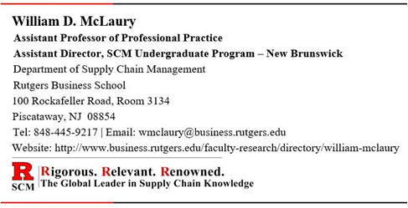
Supply Chain
Management
Operations Management
with LEAN and Six Sigma
William McLaury
Associate Professor of Professional Practice
Director, SCM Undergraduate Program – New Brunswick
Department of Supply Chain Management
Rutgers Business School
100 Rockafeller Road, Rm. 3134, Piscataway, NJ 08854
Tel: 848-445-9217 | Email: wmclaury@business.rutgers.edu
Website: http://www.business.rutgers.edu/faculty/william-mclaury

Slide 2

Operations Management
Operations Management refers to managing the process to convert resources into goods and services, in alignment with the company's business strategy as efficiently and effectively as possible, while also controlling costs.
The nature of how Operations Management is carried out varies by company and depends on the nature of the products or services in the portfolio.

Slide 3
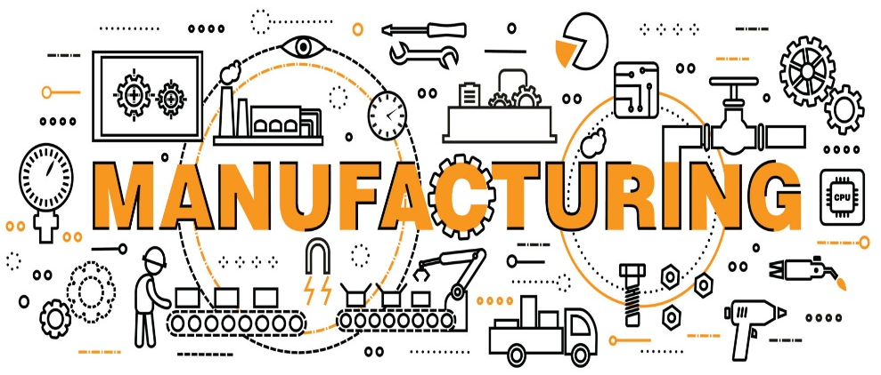
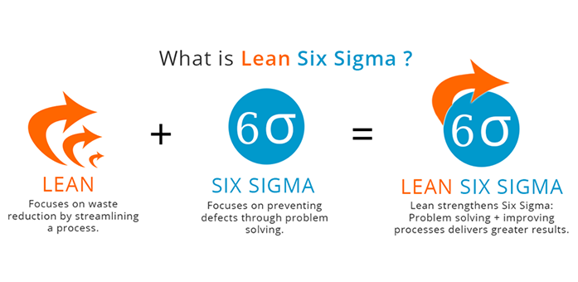
Discussion Outline
Manufacturing
Manufacturing Strategies
Manufacturing Processes
Total Cost of Manufacturing
LEAN and Six Sigma
History and Definition of LEAN
Elements of LEAN Manufacturing
Respect for People
Total Quality Management (TQM)
History and Definition of Six Sigma
Methodology & Technical Tools

Slide 4
Manufacturing
To process or make raw materials or components into a finished product, especially by means of a large-scale industrial operation, i.e., mass production.
Manufacturing involves the entire process of converting the raw material(s) or the component(s) into a finished goods item.
It includes the machines used, the personnel involved, inventory handling, warehousing, etc.
Manufacturing Management is the management of all the processes which are involved in manufacturing.
“Make It” - Manufacturing and Operations
(3:50 minutes)

Slide 5
Discussion Outline
Manufacturing
Manufacturing Strategies
Manufacturing Processes
Total Cost of Manufacturing
LEAN and Six Sigma
History and Definition of LEAN
Elements of LEAN Manufacturing
Respect for People
Total Quality Management (TQM)
History and Definition of Six Sigma
Methodology & Technical Tools

Slide 6

Manufacturing Strategies
Companies must develop a manufacturing strategy that suits the type(s) of products that they produce, their customer’s expectations, and their strengths.
Manufacturing strategies can vary significantly depending on the product and/or the customer requirements.
Developing a manufacturing strategy that suits a company's strengths is essential for establishing and maintaining an effective supply chain.

Slide 7
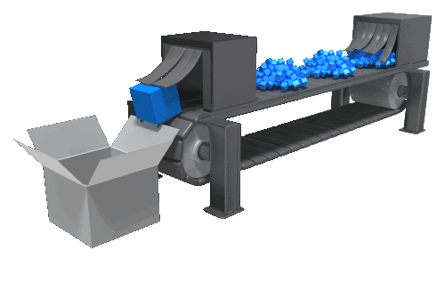
Major Manufacturing Strategies
Make-to-Stock (MTS)
Make-to-Order (MTO)
Assemble-to-Order (ATO)
Engineer-to-Order (ETO)

Slide 8
Make-to-Stock (MTS)
Make-to-Stock (MTS) - means to manufacture products for stock based on demand forecasts. Push system.
Since accurate forecasts will prevent creating excess inventory and avoid stockouts, the critical issue is how to forecast demands accurately.
Most daily necessities such as foods, sundries, and textiles are MTS-type products.
The challenge of MTS is to avoid having excess inventory.
Companies that operate with a MTS model tend to hold more inventory just in case they need it, therefore, they struggle to ensure that inventory levels don’t get out of control.

Slide 9
Make-to-Order (MTO)
Make-to-Order (MTO) is a manufacturing strategy in which manufacturing starts only after a customer's order is received.
This strategy creates additional wait time for the customer to receive the product, but allows customers to purchase products that are customized to their specifications.
The MTO strategy relieves the problems of excessive inventory that is common with the Make-to-Stock strategy.
MTO is not appropriate for all types of products.
It is not appropriate for products where customers expect immediate availability/delivery. Example: Grocery items
It is appropriate for highly configured products. Examples: aircraft, ocean vessels, bridges, or products that are very expensive to keep in inventory.

Slide 10
Assemble-to-Order (ATO)
Assemble-to-Order (ATO) is a manufacturing strategy where products ordered by customers are produced quickly and are customizable to a certain extent.
The ATO strategy requires that the basic parts for the product are already manufactured but not yet assembled.
Once an order is received, the parts are assembled quickly into the finished product which is then sent to the customer.
Example: Dell Laptop Computers
ATO is a hybrid strategy, attempting to combine the benefits of both Make-to-Stock and Make-to-Order strategies, getting products into customers' hands quickly while allowing for some customization to take place.

Slide 11
Engineer to Order (ETO)
Engineer-to-Order (ETO) is a manufacturing strategy in which the product is designed, engineered, and built to the customer’s specifications after receipt of the order.
It is a more dramatic evolution of Make-to-Order strategy.
ETO involves building a unique product every time. There may be components that are common from one product to another, but the finished product is different each time.
Example: Customized piece of manufacturing equipment
In the ETO world, the cost of poor quality can be very high.
The warranty costs, and the cost of rework to replace an item in a complex assembly, can have a serious negative effect on profit margins.

Slide 12
The manufacturing strategy defines what cycle time (i.e., lead time) the customer will experience for delivery
Manufacturing Strategy -vs- Performance Cycle
Product Design
Procurement Cycle
Manufacturing Cycle
Customer
Delivery Cycle
MTS Strategy
ATO Strategy
MTO Strategy
ETO Strategy
Total Cycle Experienced by Customers.
TIME

Slide 13
Discussion Outline
Manufacturing
Manufacturing Strategies
Manufacturing Processes
Total Cost of Manufacturing
LEAN and Six Sigma
History and Definition of LEAN
Elements of LEAN Manufacturing
Respect for People
Total Quality Management (TQM)
History and Definition of Six Sigma
Methodology & Technical Tools

Slide 14
Manufacturing Processes
Part of any manufacturing strategy involves developing a manufacturing process that can create the exact product that has been designed.
Although there are differences between companies, many manufacturing processes have certain characteristics in common.
Based on these characteristics, processes can be grouped into two broad categories:
Intermittent Processes – used to produce a large variety of products with different processing requirements in lower volumes.
Repetitive Processes – used to produce one, or a few, standardized products in high volumes.

Slide 15
Types of Manufacturing Processes
High
Intermittent Product System
Job Shop Production
Batch
Production
Repetitive Product System
Variety
Line Flow Production
Continuous Flow Production
Volume
Low
High

Slide 16
Job Shop Production (a.k.a., Project Production)
Creates a custom product for each customer
One-off or small number of items produced, generally one unit manufactured at a time.
High customization - Normally made to customs specifications
Often undertaken by small, specialist businesses
Examples:
Architects - Custom Home Construction
Ship Builders
Road Builders

Slide 17
Batch Production
Manufacturing of a small fixed quantity of an item in a single production run.
Each individual item in the batch goes through one stage of the production process before the whole batch moves on to the next stage.
Aims to achieve better use of equipment
Produces good quality products more economically than manufacturing them individually
Examples:
Bakeries
Textiles
Furniture
Pharmaceuticals

Slide 18
Line Flow Production (a.k.a., Mass Production)
For standardized products with a limited number of variations
Product moves on an assembly line through various stages of production
When one task is finished the next task must start immediately, therefore, time taken on each task must be the same
Examples:
Automobile Assembly
Cell Phones
Toilet Paper

Slide 19
Continuous Flow Production
High capital investment – frequently dedicated to one specific product
Involves a series of processes which raw materials flow through. These processes are very inflexible.
Generally highly automated, and workers act as monitors rather than as active participants.
Typically, production runs 24 hours a day with the end result being a large quantity of finished product
Examples:
Oil Refining / Gasoline
Cement
Laundry Detergent
Chemicals

Slide 20
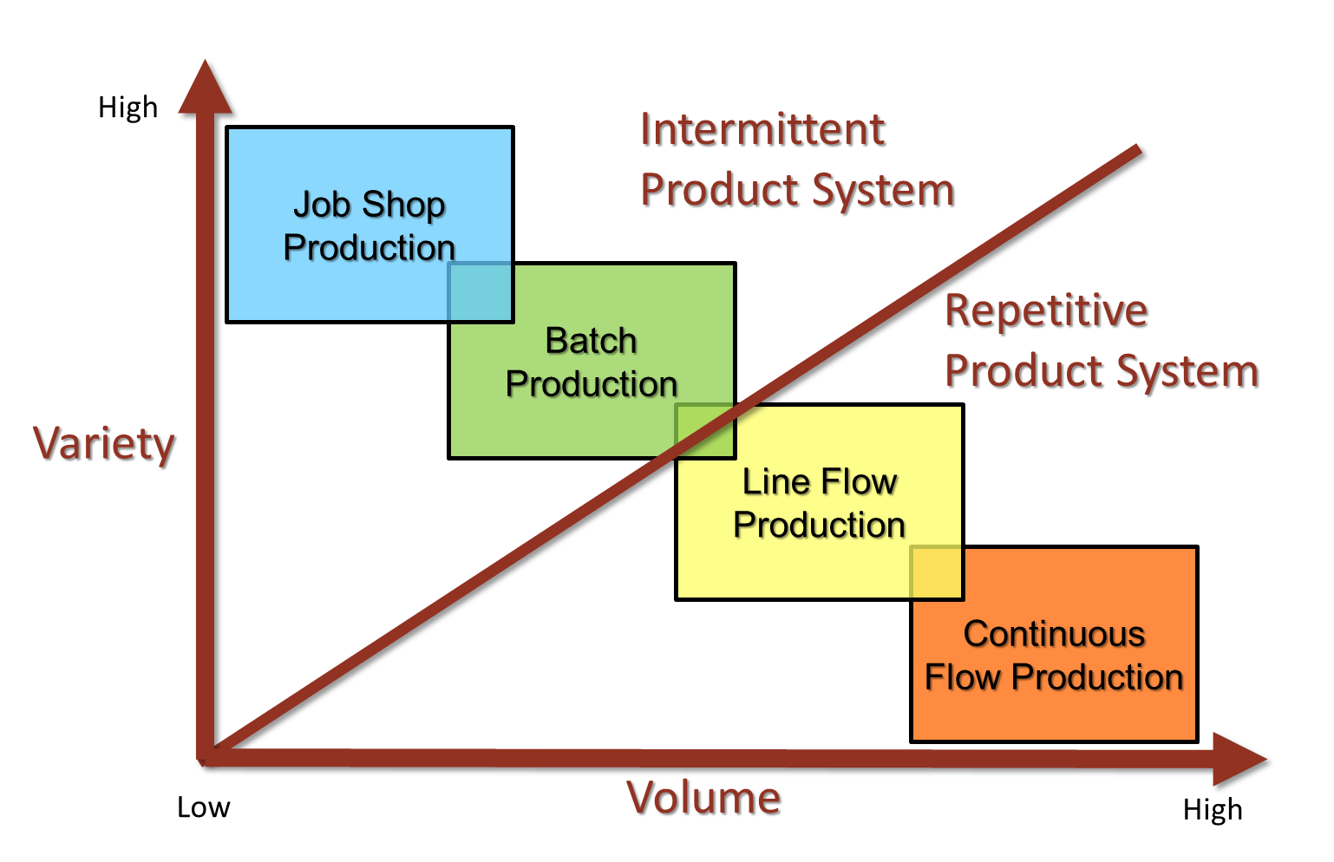
Manufacturing Process –vs- Manufacturing Strategy
Category | Process | Product |  | Strategy | Lead time
 |  | Variety | Volume
Intermittent | Job Shop | Very High | Very Low | ETO, MTO | Very Long
 | Batch | High | Low | MTO, ATO | Long
Repetitive | Line Flow | Limited | High | ATO, MTS | Short
 | Continuous Flow | Very Limited | Very High | MTS | Very Short

Slide 21
Discussion Outline
Manufacturing
Manufacturing Strategies
Manufacturing Processes
Total Cost of Manufacturing
LEAN and Six Sigma
History and Definition of LEAN
Elements of LEAN Manufacturing
Respect for People
Total Quality Management (TQM)
History and Definition of Six Sigma
Methodology & Technical Tools

Slide 22

Total Cost of Manufacturing
Total Cost of Manufacturing (TCM) is the complete cost of producing and delivering products to your customers.
It incorporates both fixed and variable costs used in the manufacturing, storage, and delivery of the product.
TCM is generally expressed as cost per unit
TCM includes:
Manufacturing and Procurement activities
Inventory and Warehousing activities
Transportation activities

Slide 23
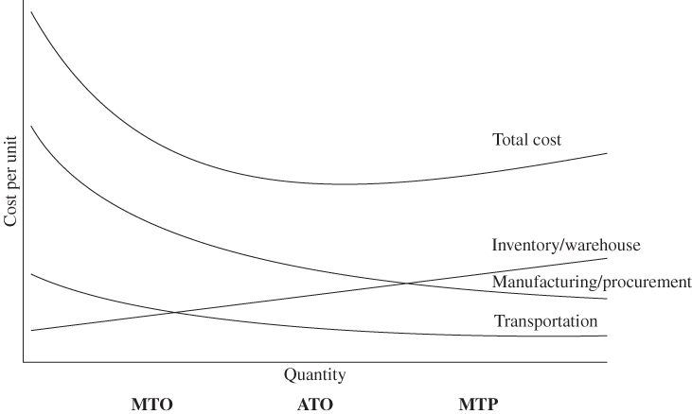
TCM -vs- Strategic Alternatives
As volume goes up . . .
Manufacturing and Procurement costs go down due to economies of scale. Generally-step function applies as more capital is required to produce.
Inventory and Warehousing costs go up.
Transportation costs go down, but level off at high volumes as the shipping container gets filled to capacity and another container must be used.
ETO
MTO
ATO
MTS

Slide 24
Discussion Outline
Manufacturing
Manufacturing Strategies
Manufacturing Processes
Total Cost of Manufacturing
LEAN and Six Sigma
History and Definition of LEAN
Elements of LEAN Manufacturing
Respect for People
Total Quality Management (TQM)
History and Definition of Six Sigma
Methodology & Technical Tools

Slide 25
LEAN and Six Sigma
LEAN – is an operating philosophy of waste reduction and value enhancement. It was originally created as the Toyota Production System (TPS) by key Toyota executives.
Six Sigma – is a disciplined, statistical-based, data-driven methodology for identifying and removing the causes of defects (errors) and minimizing variability in manufacturing and in business processes. It was originally developed by Motorola.

Slide 26



LEAN and Six Sigma (continued)
Lean improves the supply chain “flow” by eliminating waste
Six Sigma improves the supply chain “process” by reducing variation
Combining Lean with Six Sigma results in smooth and steady flow
LEAN and Six Sigma complement one another

Slide 27
Discussion Outline
Manufacturing
Manufacturing Strategies
Manufacturing Processes
Total Cost of Manufacturing
LEAN and Six Sigma
History and Definition of LEAN
Elements of LEAN Manufacturing
Respect for People
Total Quality Management (TQM)
History and Definition of Six Sigma
Methodology & Technical Tools

Slide 28
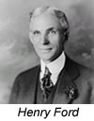
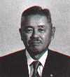


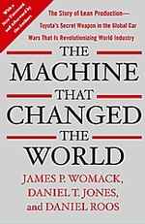
LEAN History
Starting in the 1910’s, Henry Ford’s mass production line was a first breakthrough by using continuous assembly systems that made parts find their way into finished products
In the 1940’s, Taichii Ohno and Shigeo Shingo created the Toyota Production System (TPS), which incorporated Ford’s production system and other techniques to form the basis of what is now known as LEAN.
The term LEAN was first coined by John Krafcik in 1988 and the definition was expanded in the 1990 book, The Machine that Changed the World.
Assembly Line Video
(5 mins)

Slide 29
LEAN History (continued)
In the 1990s, Supply Chain Management combined:
Quick Response - the rapid replenishment of a customer's stock by a supplier with direct access to data from the customer's point of sale.
Efficient Consumer Response (ECR) - a strategy to increase the level of services to consumers through close cooperation among retailers, wholesalers, and manufacturers.
Just-in-Time (JIT) - an inventory strategy to decrease waste by receiving materials only when and as needed in the production process, thereby reducing inventory costs.
Keiretsu Relationships - involves companies both upstream and downstream of a manufacturing process, remaining independent but working closely together for mutual benefit
The combination of these concepts have emerged as the philosophies and practices known as LEAN Manufacturing

Slide 30
What Lean is
Lean is a management philosophy based on the Toyota Production System (TPS)
Eliminate everything that does not add value (waste) in the customer’s eyes
Objective
Using Value Stream Mapping as primary work unit
Focusing on improving process performance
Having a clear view of the end state
Focus and Scope
A wide range of Lean tools are available
Learn-by-doing approach to performance improvement and capability-building
Approach and Tools

Slide 31

What Lean is NOT
Laying off employees by the bus load
Delivering less or working harder
Outsourcing or offshoring
A cost reduction program
Just a set of “tools” like 5S, kaizen events, etc.
Automation or buying a monstrous ERP system
Winning a Shingo Prize so as to look Lean

Slide 32
Lean Facilitates a Culture Change
Culture
Culture Change
Attitude
Change the way we think
Behavior
Work Systems
& Processes
Change the way we act
Eliminate Waste

Slide 33
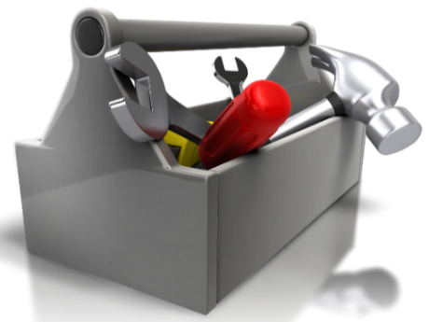
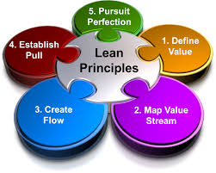
LEAN . . .
LEAN is NOT a tool box of methods, ideas, or methodologies, it is philosophy / culture
The goal of LEAN is the elimination of waste and the minimization of the amount of all resources used in the operation of a company
LEAN is standard in many industries
LEAN regularly results in:
Large cost reductions
Improved quality
Increased customer service

Slide 34
Understand “Value”
Value is defined as the inherent worth of a product as judged by the customer, and reflected in its selling price and market demand.
It is any activity that increases the market, form, or function of the product/service.
Things for which the customer is willing to pay.
Value Added Process
Process steps that transform or shape a product or service which is eventually sold to a customer.
Non-Value Added Process
Process steps that take time, resources, or space, but do not transform or shape the product or service.

Slide 35
Work versus Waste
Value-Added Activities
Non-Value Added Incidental Waste
Non-Value Added Pure Waste
Transform or shape material or information
Customer wants it and is willing to pay for it
Done right the first time
No value created but
required by current thinking
required by process limitations
required by current technology
required by current regulations
Consumes resources but creates no value for the customer
Could be stopped and it would be invisible to the customer
FOCUS HERE FOR IMPROVEMENT

Slide 36
Discussion Outline
Manufacturing
Manufacturing Strategies
Manufacturing Processes
Total Cost of Manufacturing
LEAN and Six Sigma
History and Definition of LEAN
Elements of LEAN Manufacturing
Respect for People
Total Quality Management (TQM)
History and Definition of Six Sigma
Methodology & Technical Tools

Slide 37
Components of LEAN
LEAN is composed of three components working in unison:
LEAN Manufacturing
Respect for People
Total Quality Management
A
LEAN Manufacturing
C
B
Total Quality Management
Respect for People

Slide 38
LEAN Manufacturing
LEAN Manufacturing is a natural fit within the discipline of Supply Chain Management as all of the LEAN goals and objectives help to facilitate an efficient and effective supply chain.
Satisfying internal customer demand
Communicating demand forecasts and production schedules up the supply chain
Quickly moving products in the production system
Optimizing inventory levels across the supply chain
Increasing the value, capabilities, and flexibility of the workforce through cross-training
Extending collaboration and alliances beyond just 1st tier suppliers and customers to include 2nd and 3rd tier suppliers and customers as well

Slide 39
Elements of LEAN Manufacturing
Waste Reduction
LEAN Layouts
Inventory, Setup Time, & Changeover Time Reduction
Small Batch Scheduling and Uniform Plant Loading
LEAN Supply Chain Relationships
Workforce Empowerment
Continuous Improvement

Slide 40

Waste Reduction
Firms reduce costs and add value by eliminating waste from the production system.
Waste encompasses wait times, inventories, material and people movement, processing steps, variability, any other non-value-adding activity.
Before waste is removed, processes are often scattered, which can negatively affect your customers
After waste is removed, processes are more streamlined, resulting in more satisfied customers. You’ll also save your organization time and money

Slide 41
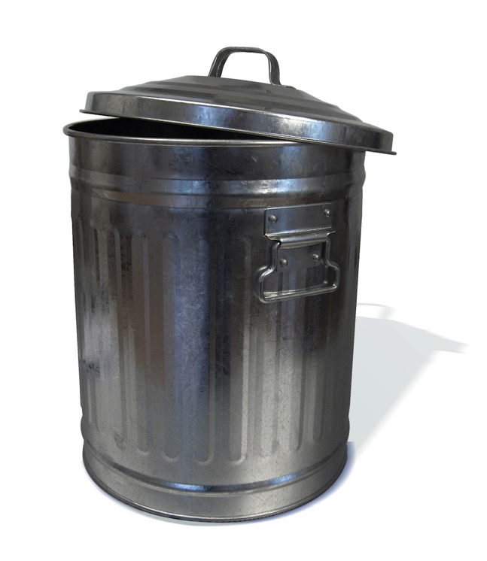
Waste Categories (remember the acronym “DOWN TIME”) :
Defects
Work not done right the first time such as scrap and rework
Extra-Processing
Processing beyond the standard required by the customer
Overproduction
Producing sooner, faster or in greater quantities than customer demand
Motion
Unnecessary movement of people, or multiple hand-offs
Waiting
People or parts that wait for a work cycle to be completed
Waste
Inventory
Raw material, WIP or finished goods which is not having value added to it
Non-Utilized Talent
Not using employees full intellectual contribution
Transportation
Unnecessary movement of materials or parts between processes

Slide 42
Benefits of LEAN Waste Reduction
Typically, only 1 - 10% of the process steps or activities are value added
Value Added
Process Steps
Before
Non-Value Added
Process Steps
After
Implement LEAN to reduce the waste (non-value added)
Reducing wastes consequently results in:
Reduced cycle times
Greater throughput
Better productivity
Improved quality
Reduced costs
All of these can improve customer satisfaction and provide the company with a competitive advantage!!

Slide 43


LEAN Layout
Move people and materials when and where needed, and as soon as possible
Are very visual (lines of visibility are unobstructed) with operators at one processing center able to monitor work at another
Manufacturing cells
Process similar parts or components saving duplication of equipment and labor
Are often U-shaped to facilitate easier operator and material movements

Slide 44
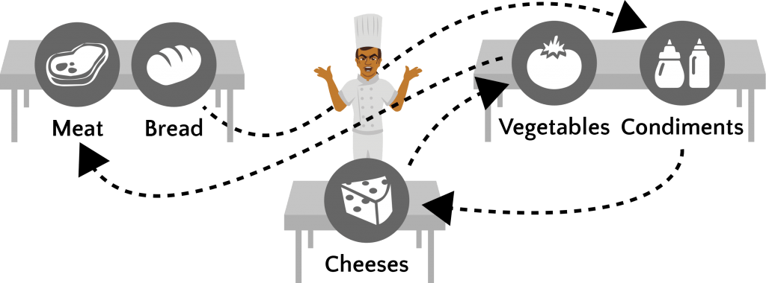
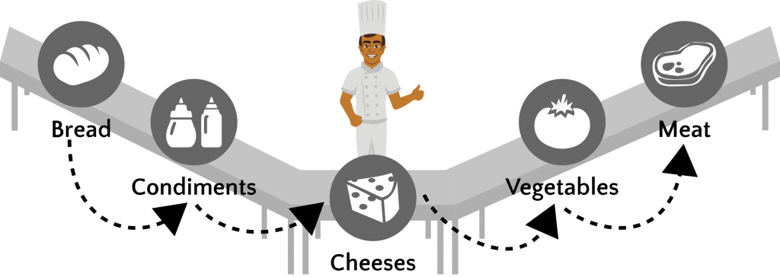
EXAMPLE: LEAN Layout
(Sandwich Shop)
Before LEAN Layout
After LEAN Layout

Slide 45
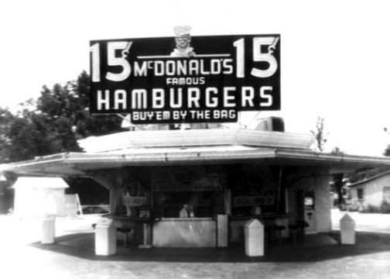
EXAMPLE: LEAN Layout
(McDonalds - Speedee Service System)
Richard "Dick" (1909-1998) and Maurice "Mac" (1902-1971) McDonald first opened their restaurant in 1940, but re-created it in 1948 on the model of their "Speedee Service System".
The Speedee Service System applied the principles of a LEAN Layout to fast food preparation, and formed the foundation of what Ray Kroc would later leverage into the world's largest food outlet chain, “McDonalds”.
https://youtu.be/jTageuhPfAM
The McDonalds LEAN Layout =
The LEAN Layout in operation =
(2:50 minutes)
https://youtu.be/t--nPZLDFOU
(1:26 minutes)
Excerpted from the movie “The Founder”

Slide 46
The Five-S’s
These were originally Japanese words relating to industrial housekeeping
5-S, or the five pillars of the visual workplace, is a systematic process of workplace organization.
Japanese S-Term (Don’t worry about these terms) | English S-Term (Only study these terms)
1. Seiri | Sort – Keep only necessary items in the workplace, eliminate the rest
2. Seiton | Set in Order – Organize and arrange items to promote an efficient workflow
3. Seiso | Shine – Clean the work area so it is neat and tidy
4. Seiketsu | Standardize – Schedule regular cleaning and maintenance
5. Shitsuke | Sustain – Stick to the rules. Maintain and review the standards
“There is a place for everything, and everything should be in its’ place”

Slide 47
The Five-S’s (continued)
Focuses on effective workplace organization and standardization. It allows us to easily spot variation from standard operating conditions.
Cleaner, safer work environment
Organized, user friendly workstations
Open up space and reduce clutter
Standardize
Sort
Sustain
Shine
Set In Order

Slide 48

Inventory, Setup Time, & Changeover Time Reduction
Some inventory may be necessary, but excess inventory is a waste
Excess inventory takes up space, and costs money to hold, maintain, protect, secure, and insure.
It ties up financial capital which could be used for other aspects of the business.
Reducing inventory can free up capital and reduce holding costs.
There is less likelihood of waste being created by obsolescence, expiry, spoilage, or damage with lower inventory levels.

Slide 49
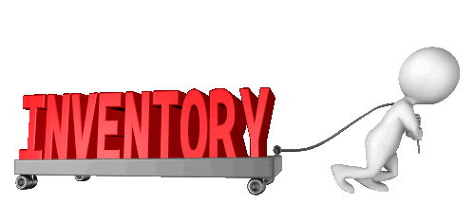
The Pull System
Traditional Approach:
Supply chains work as “push” systems, and inventory is carried to cover up problems
Pull Approach:
Each stage in the supply chain requests quantities needed from the previous stage.
No excess inventory is generated.
Reducing inventory levels can also uncover production problems.

Slide 50


What do you see? . . .
Water level is high
Water level is low
The water represents inventory. When the water level is high, you don’t see the rocks beneath the water, so you may not know that they are there.
The rocks represent hidden obstacles, problems, and issues.
Inventory can hid the underlying problems, but they are still there and can potentially create major issues in the supply chain.
Lowering inventory will help to expose the hidden problems. Once the problems are detected, they can be solved. The end result will be a smoother running supply chain with less inventory investment.

Slide 51
Setup Time and Changeover Time Reduction
Setup Time and Changeover Time are both considered a waste as they are times when the equipment is not performing its intended function . . . . producing product.
Setup Time is the time taken to prepare and format the manufacturing equipment and systems for production.
Changeover Time is the time taken to adapt and modify the manufacturing equipment and systems to produce a different product or a new batch of the same product.
While setting up the equipment is a necessary function, if the set up time can be minimized, the difference will be more time available to produce.
Both setup and changeover are non-value added operations and should be minimized as much as possible.

Slide 52

Small Batch Scheduling & Uniform Plant Loading
The ideal schedule is to produce every product as quickly as possible and at the same rate as customer demand.
In the real world, material availability, labor availability, and setup or changeover time influences the scheduling of large batches
Large batches can exacerbate the Bullwhip Effect as production in large batches creates an uneven workload
Production is not synchronized with customer demand, making a pull system impossible.
Throughput times in manufacturing go up, and work-in-process inventory goes up, creating more waste in the system.
Think of a snake trying to swallow a large meal.

Slide 53
Small Batch Scheduling
LEAN Manufacturing attempts to reverse this though small batch scheduling.
Smaller batches will facilitate producing at the same rate as customer demand.
Production in small batches creates a smooth workload as production can be synchronized with customer demand, facilitating a pull system.
It increases flexibility allowing the company to respond to changes in customer demands more quickly.
Throughput times in manufacturing go down, and Work-in-Process inventory goes down, reducing costs and eliminating or minimizing waste in the system.

Slide 54


Kanbans
Small batch scheduling can be facilitated through the use of Kanbans:
Kanban means “Signal” or “Card” in Japanese and is used for communication (e.g., visual signal) between workstations.
Kanban’s authorize production or the movement of materials to the next workstation.
Could be facilitated through the use of a computer software program, i.e., ERP system.

Slide 55
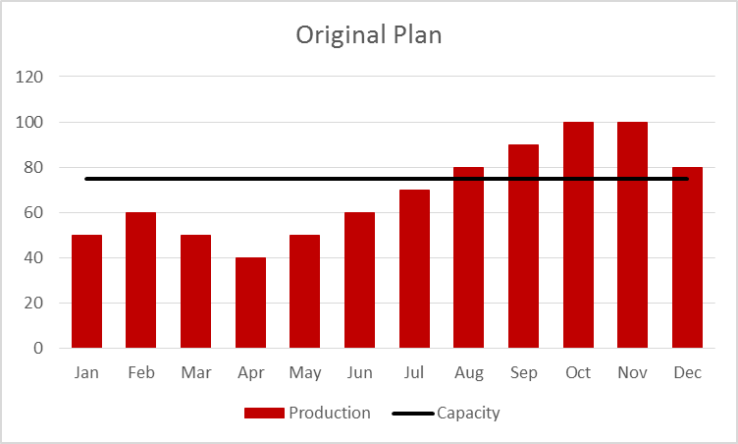
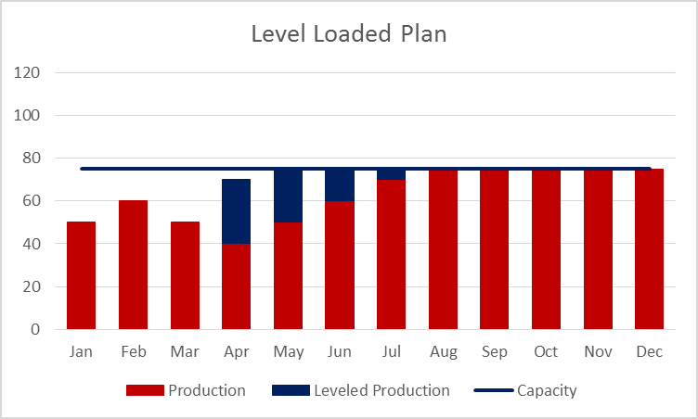
Uniform Plant Loading (i.e., level-loading the plan)
Problem:
Demand exceeds capacity at points in the planning horizon.
Matching the production plan to follow demand exactly can contribute to inefficiency and waste, including excess inventory or shortages of inventory.
Uniform Plant Loading:
Planning up to capacity in earlier time periods to meet demand in later time periods.
Also called “front-loading” the plan or “leveling” the plan.
Production schedule is frozen in the up-front time period (i.e., month)
Helps suppliers better plan production.
Very inefficient use of resources
Over-capacity
Under-capacity
More efficient use of resources
Production
shifted forward

Slide 56

LEAN Supply Chain Relationships
Firms develop lean supply chain relationships with key customers and key suppliers.
In an ideal LEAN supply chain relationship, both customers and suppliers get connected in ways that allow them to easily exchange information, demand data, and the visibility of status.
Mutual dependency and benefits occur among these partners.
Suppliers and customers work to remove waste, reduce cost, and improve quality and customer service

Slide 57

Workforce Commitment
Managers must support LEAN Manufacturing by providing subordinates with the skills, tools, time, and other necessary resources to identify problems and implement solutions
Managers can also create a culture in which workers are encouraged to speak out when problems are found.
In LEAN Manufacturing, employees are cross-trained on many of the various production processes to enable capacities to be adjusted as needed when machines break down or when workers are absent.

Slide 58
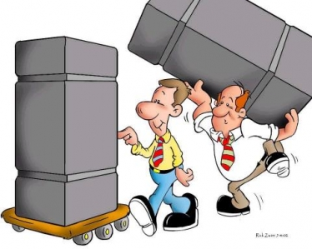
Continuous Improvements (Kaizen)
A system involving every employee that is based on making little changes on a regular basis, anywhere changes can be made, to reduce process, delivery, and quality problems.
Continuous small improvements
Changes are implemented quickly
Everyone gets involved

Slide 59
Discussion Outline
Manufacturing
Manufacturing Strategies
Manufacturing Processes
Total Cost of Manufacturing
LEAN and Six Sigma
History and Definition of LEAN
Elements of LEAN Manufacturing
Respect for People
Total Quality Management (TQM)
History and Definition of Six Sigma
Methodology & Technical Tools

Slide 60

Respect for People
Respect for all people must exist for an organization to be at its best
LEAN involves a flatter hierarchy than traditional organizations.
Ordinary workers are given greater responsibility.
Supply chain members work together in cross functional teams.
The goal is NOT to reduce the number of people in an organization, it is to use people resources more wisely.
Next, we will examine the Role of Workers, Management, and Suppliers

Slide 61
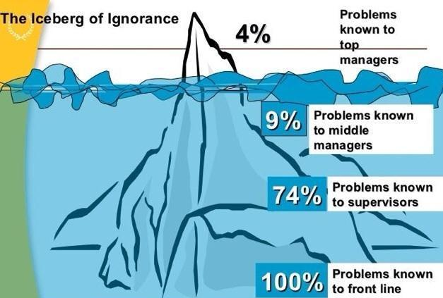
The Role of Workers
Perform tasks and actively pursuing company goals:
Improve production process
Correct quality problems
Monitor quality
Work in Teams (i.e., Quality Circles)
workers

Slide 62

The Role of Management
Create the cultural change needed for LEAN to succeed:
Provide an atmosphere of cooperation.
Empower workers to take action based on their ideas.
Develop incentive systems to recognize and reward LEAN behaviors.

Slide 63

The Role of Suppliers
LEAN involves building long-term supplier relationships
Partnerships with suppliers.
Improving process quality.
Sharing information.
The goal is to have the fewest number of high-quality suppliers possible without unnecessarily increasing risk.

Slide 64
Discussion Outline
Manufacturing
Manufacturing Strategies
Manufacturing Processes
Total Cost of Manufacturing
LEAN and Six Sigma
History and Definition of LEAN
Elements of LEAN Manufacturing
Respect for People
Total Quality Management (TQM)
History and Definition of Six Sigma
Methodology & Technical Tools

Slide 65
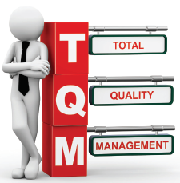
Total Quality Management
Quality Management Video
(3:19 minutes)
Total Quality Management (TQM) is a management philosophy based on the principle that every employee must be committed to maintaining high standards of work in every aspect of a company's operations.
TQM is a combination of quality and management tools which are designed to increase business and reduce losses resulting from wasteful practices.
Six Sigma is an integral part of Total Quality Management.
The key principles of TQM are:
Management Commitment
Employee Empowerment
Fact Based Decision Making
Continuous Improvement
Customer Focus

Slide 66
Total Quality Management (continued)
There is no single academic formalization of total quality, however, a number of noted quality experts all contributed to the basic framework
W. Edwards Deming - is widely considered the father of TQM. He is the creator of the Plan-Do-Check-Act model.
Philip Crosby – coined the phrase “quality is free” (which is also the title of his book) as defects are costly. He introduced the concepts of zero defects, and focus on prevention and not inspection.
Joseph Juran – defined quality as “fitness for use”. He developed the concept of the cost of quality.
Kaoru Ishikawa – developed one the first tools in the quality management process, the cause and effect diagram, which is also called the "Ishikawa" or "fishbone" diagram.

Slide 67
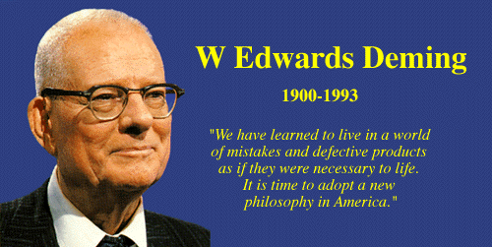
W. Edwards Deming
Stressed management’s responsibility for quality. He developed 14 points to guide companies in quality improvement.
Create constancy of purpose to improve product and service
Adopt the new philosophy
Cease dependence on inspection to improve quality
End the practice of awarding business on the basis of price
Constantly improve the production and service system
Institute training on the job
Institute leadership
Drive out fear
Break down barriers between departments
Eliminate slogans and exhortations
Eliminate quotas
Remove barriers to pride of workmanship
Institute program of self-improvement
Put everyone to work to accomplish the transformation
In God we trust.
All others bring data

Slide 68
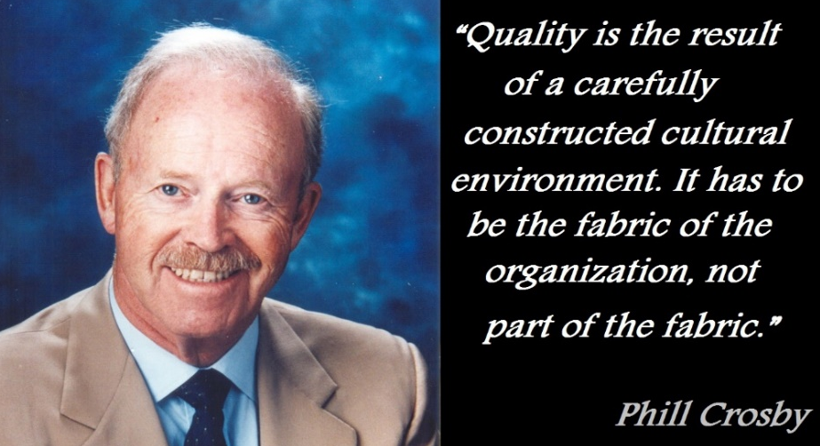
Philip Crosby
He introduced the concepts of zero defects, and the focus on prevention not inspection.
Demonstrated what a powerful tool the cost of quality could be to raise awareness of the importance of quality.
Referred to the cost of quality as the “price of nonconformance” and argued that organizations choose to pay for poor quality.
He introduced the four absolutes of quality:
Quality is conformance to requirements
The system of quality is prevention.
Performance standard is zero defects.
The measure of quality is the price of nonconformance

Slide 69
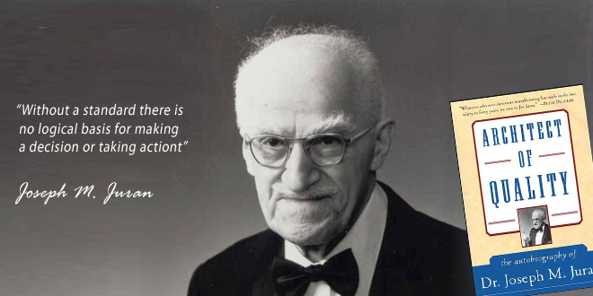
Joseph Juran
Quality Planning: identify internal / external customers and needs
Develop products satisfying those needs.
Mangers set goals, priorities, and compare results.
Quality Control: determine what to control
Establish standards of performance.
Measure performance, interpret the difference, take action.
Quality Improvement: show the need for improvement
Identify projects for improvement.
Implement remedies
Provide control to maintain improvement.

Slide 70
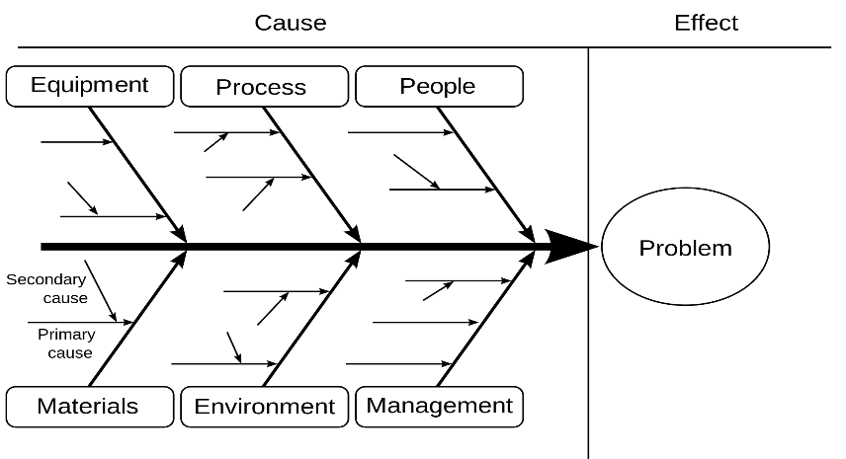
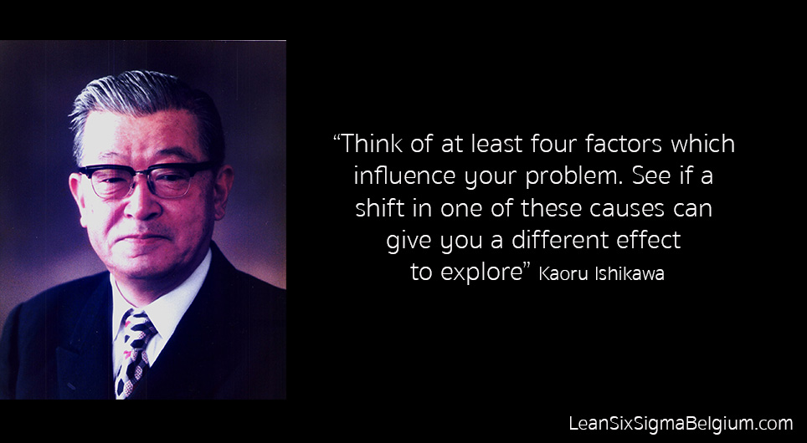
Kaoru Ishikawa
Developed one the first tools in the quality management process, the Cause and Effect Diagram, which is also called the "Ishikawa" or "fishbone" diagram.
With this tool, the user can see all possible causes of a problem to help find the root cause.
He is also known as the father of quality circles and helped bring this concept into the mainstream.
Further, he was a proponent of continuous customer service, meaning that a customer should continue receiving service even after receiving the product.

Slide 71

Voice of the Customer (VOC)
Term used in business to describe the in-depth process of capturing internal and external customer's expectations, preferences, likes, and dislikes.
The VOC can be captured in a variety of ways:
Customer Interviews
Market Surveys
Focus Groups
Customer Specifications
Observation
Warranty Data
Field Reports
Complaint Logs
This data is used to identify the quality attributes needed for a process or product.

Slide 72
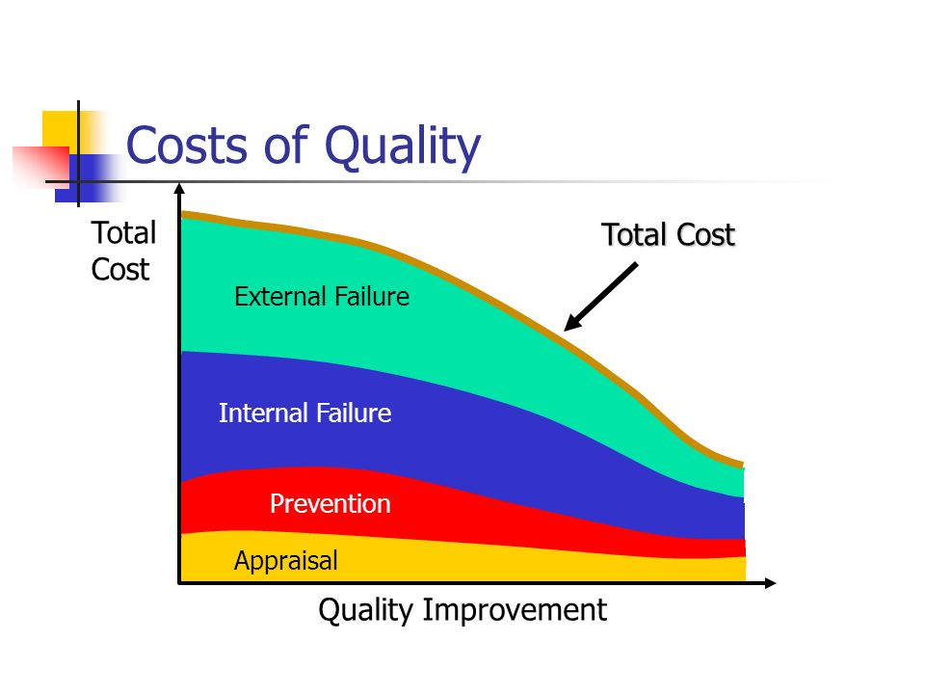
Cost of Quality
An approach that supports a company’s efforts to determine the level of resources necessary to prevent poor quality, and to evaluate the quality of the company’s products and services.
Any cost that would not have occurred if quality was perfect, contributes to the cost of quality.
Helps a company determine the benefits and savings generated by potential process improvements.
Can be divided into the:
Cost of Good Quality
Appraisal Costs
Prevention Costs
Cost of Poor Quality
Internal Failure Costs
External Failure Costs

Slide 73
Cost of Good Quality – Appraisal Costs
Appraisal Costs are associated with the evaluation of purchased materials, processes, products, and services to ensure that they conform to specifications.
They include costs for:
Testing, evaluating, and inspecting the quality of incoming materials, process setups, and products, against agreed upon specifications.
Quality assessment and approval of suppliers.
Performing audits to confirm that the quality system is operating properly.

Slide 74
Cost of Good Quality – Prevention Costs
Prevention Costs are related to the design, implementation, and maintenance of the quality management system. They are planned, and experienced before actual products or materials are acquired or produced.
They include costs for:
Establishment of specifications for incoming materials, processes, products, and services
Creation of quality plans
Development, preparation, and maintenance of quality training
Creation and maintenance of the quality system

Slide 75
Cost of Poor Quality – Internal Failure Costs
Internal Failure Costs occur when the product or service does not meet the designed quality standards, and are identified before the product or service is delivered to the customer.
They include costs for:
Defective product or material that cannot be used, sold, or repaired, and the costs associated with correction of these defects.
Unnecessary work or inventory resulting from errors.
Activities required to establish the root causes of product or service failures.

Slide 76
Cost of Poor Quality – External Failure Costs
External Failure Costs occur when the product or service does not meet the designed quality standards, but is not detected until after the product or service is delivered to the customer.
They include costs for:
Handling and responding to customer complaints.
Failed products that must be replaced or services that are repeated.
Repair of returned products and products still in the field.
Handling and investigation of rejected or recalled products, including return transportation costs.

Slide 77
Acceptance Sampling
When a shipment is received from a supplier, a statistically significant representative sample is taken and measured against the quality acceptance standard.
The entire shipment is assumed to have the same quality as the representative sample that was taken.
Sampling is less time-consuming than testing every unit but can result in errors:
Supplier’s Risk: The buyer rejects a shipment of good-quality units because the sample quality level did not meet the acceptance standard (type I error)
Buyers’s Risk: The buyer accepts a shipment of poor-quality units because the sample falsely provides a positive result against the acceptance standard (type II error)

Slide 78
Discussion Outline
Manufacturing
Manufacturing Strategies
Manufacturing Processes
Total Cost of Manufacturing
LEAN and Six Sigma
History and Definition of LEAN
Elements of LEAN Manufacturing
Respect for People
Total Quality Management (TQM)
History and Definition of Six Sigma
Methodology & Technical Tools

Slide 79
What is Six Sigma?
A quality management process
Six Sigma focuses on improving the quality of process outputs by identifying and removing the causes of defects (errors) and minimizing variability in manufacturing and business processes.
The goal of Six Sigma is to attain less than 3.4 Defects Per Million Opportunities (DPMO)
Six Sigma is a structured and data-driven approach to drive a near-perfect quality goal, i.e., “Zero Defects”
Video: What is Six Sigma
(3.5 mins)

Slide 80

Six Sigma History
The concept of Six Sigma was originated by Motorola
Motorola developed the concept in the 1980’s, created the methodology, and copyrighted it as well.
Motorola has documented > $16 Billion in savings as a result of Six Sigma.
Thousands of companies globally have adopted Six Sigma.
This is a direct result of many of America’s leaders openly praising the benefits of Six Sigma.
Six Sigma became famous when Jack Welch made it central to his successful business strategy at General Electric in 1995
Reported $200MM in savings in the first year of implementation (1996) alone.
Chairman and CEO of General Electric 1981 -2001

Slide 81
Discussion Outline
Manufacturing
Manufacturing Strategies
Manufacturing Processes
Total Cost of Manufacturing
LEAN and Six Sigma
History and Definition of LEAN
Elements of LEAN Manufacturing
Respect for People
Total Quality Management (TQM)
History and Definition of Six Sigma
Methodology & Technical Tools

Slide 82
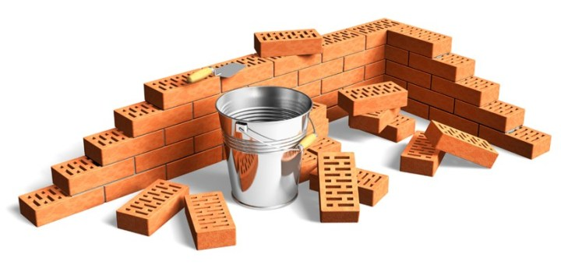
The Foundation of Six Sigma
There are three foundational aspects of Six Sigma:
Quality is Defined by the Customer
The Use of Technical Tools
People Involvement

Slide 83

Quality is Defined by the Customer
Quality and excellence are what your customers say they are. Customers of your products and services define quality!
Customers want quality that is appropriate to the price that they are prepared to pay and the level of competition in the market.
Key aspects of quality for the customer include:
Reliable – acceptable level of breakdowns or failure
Good functionality – it does the job well
Durable – lasts as long as it should
Good design – looks and style
Good after sales service
Value for money
Consistency

Slide 84

The Use of Technical Tools
Six Sigma provides a statistical approach for solving any problem and thereby improves the quality level of the product as well as the company.
Six Sigma is concerned with the permanent fix to quality problems and seeks to identify and correct the root cause of the problem through the use of Root Cause Analysis.
All employees should be trained to use the Seven Tools of Quality Control.

Slide 85
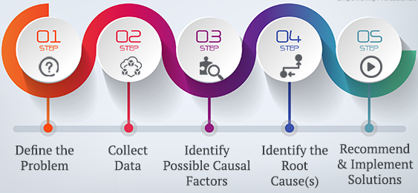
Root Cause Analysis
Root Cause Analysis (RCA) is a collective term that describes a wide range of approaches, tools, and techniques used to uncover causes of problems.
The root cause is the core issue that sets in motion the entire cause-and-effect reaction that ultimately leads to the problem(s).
Some root cause analysis approaches are geared more toward identifying true root causes than others, some are more general problem-solving techniques, and others offer support for the core activity of root cause analysis.
Root Cause Analysis Process
Next, we will examine some of the essential techniques and tools in the RCA toolbox, such as the Seven Tools of Quality Control, DMADV, DMAIC, and the 5 Why’s / 5 How’s Technique used to address a specific problem.

Slide 86
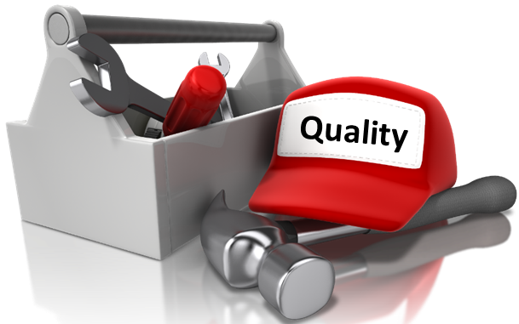
The Seven Tools of Quality Control
The Seven Tools of Quality Control are used by workers to identify and correct quality problems.
Check Sheets
Histograms
Pareto Analysis
Cause & Effect Diagrams
Flow Diagram
Control Charts
Scatter Diagrams

Slide 87
Tools of Quality Control – Check Sheets
Used to determine frequencies for specific problems

Slide 88
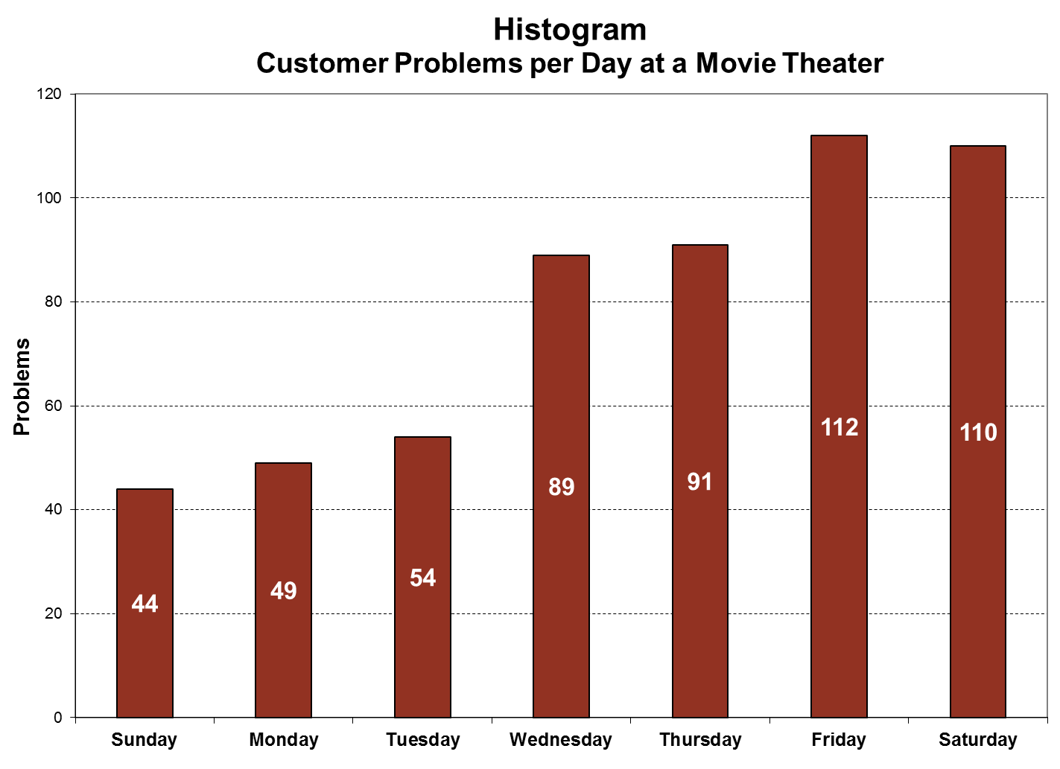
Tools of Quality Control - Histograms
A graphical display where the data is grouped into ranges

Slide 89
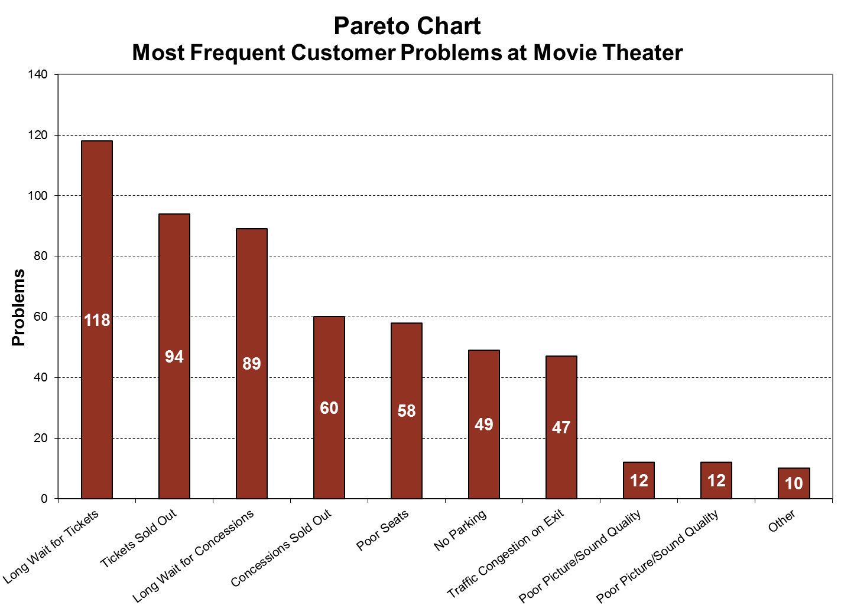
Tools of Quality Control – Pareto Analysis
For presenting data in an organized fashion, indicating process problems from most to least severe.

Slide 90
Tools of Quality Control - Cause and Effect Diagrams
Used to aid in brainstorming and isolating the causes of a problem.

Slide 91
Tools of Quality Control – Flow Diagram
Sequence of movements or actions of people or things involved in a complex system or activity
Customer Flow at a Movie Theater
Start
Customer arrives and parks car
Customer enters Movie Theater
Customer enters the ticket line
Waits
Customer buys a ticket
Customer enters concession line
Customer buys concessions
Waits
Customer enters theater
Customer searches for and finds a seat
Waits
(and watches an endless number of trailers)
Customer watches the movie
Customer leaves Movie Theater
Customer walks to the car
Customer exits the parking lot
End

Slide 92
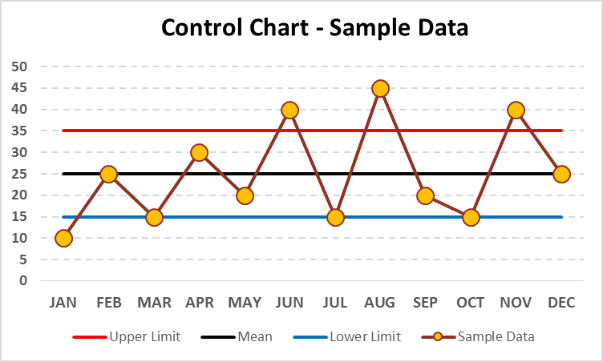
Tools of Quality Control – Control Charts
Graph to study how a process changes over time
Natural Variations
Expected and random (can’t control)
Assignable Variations
Have a specific cause (can control)
Variable Data
Continuous (e.g., weight)
Attribute Data
Indicate some attribute such as color and satisfaction, or beauty.
Process out-of-control
Process out-of-control
Firms:
Gather process performance data
Create control charts to monitor process variability
Then collect sample measurements of the process over time and plot on charts.
Allows firms to:
Visually monitor process performance
Compare the performance to desired levels or standards
Take corrective action as necessary

Slide 93
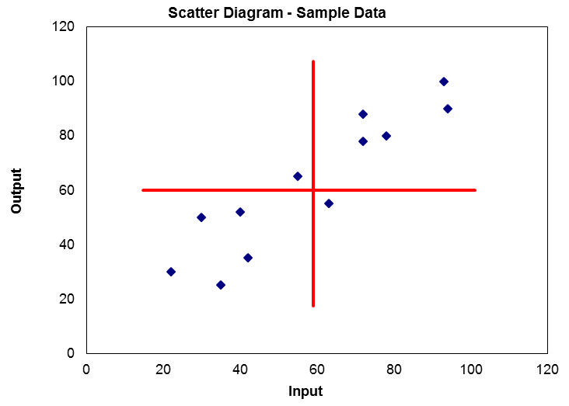
Tools of Quality Control – Scatter Diagrams
The values of two variables plotted along two axes, to reveal any correlation present.

Slide 94
Six Sigma Methodology
Six Sigma has two key methodologies:
DMADV Methodology:
Define --> Measure --> Analyze --> Design -->Verify: which is a data-driven quality strategy for designing products & processes.
This methodology is used when the company wants to create a new product design or business process that is more predictable and defect free.
DMAIC Methodology:
Define --> Measure --> Analyze --> Improve -->Control: which is a data-driven quality strategy for improving products & processes.
This methodology is used when the company wants to improve an existing product or business process.
DMAIC is the most widely adopted and recognized Six Sigma methodology in use.
It defines the steps a Six Sigma practitioner typically follows during a project.

Slide 95

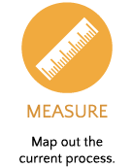
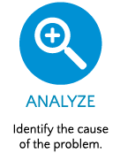
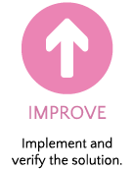

DMAIC Methodology
What is the customers’ expectation of the process?
What is the frequency of defects?
Why, when and where do defects occur?
How can we fix the process?
How can we make the process stay fixed?

Slide 96

The 5 Why’s Technique
The “5 Whys,” is a questioning technique for identifying the root cause of a problem.
By repeatedly asking the question “Why” (five is a good rule of thumb), you can peel away the layers of symptoms which can lead to the root cause of a problem (i.e., the underlying factors or causes of an event).
At this point you understand the root cause, and can see where a change is needed.
5 Whys is used in the “Analyze” phase of the Six Sigma DMAIC (Define, Measure, Analyze, Improve, Control) methodology.

Slide 97

The 5 How’s Technique
The “5 How's,” is a questioning technique for drilling down into the details of a potential solution to a known problem.
It is designed to bring clarity and refinement to a solution and arrive the root solution (best solution).
5 How’s is a useful method of brainstorming resolutions to the root causes and developing action items to resolve the problem.
Think of this activity as being halfway up a ladder, with 5 steps above it and 5 below. You go up the ladder by asking "why" and down it by asking "how."
The 5 Whys and 5 How’s are typically used in conjunction with the Cause and Effect Diagram.

Slide 98

People Involvement
A company must involve all its employees in the Six Sigma program, and provide opportunities and incentives for employees to focus their talents on satisfying customers.
It is important that all Six Sigma team members are assigned specific well-defined Six Sigma roles with measurable objectives.
All employees are responsible to identify quality problems.

Slide 99
Six Sigma Training and Certification Levels
Six Sigma certification levels based on training, knowledge, and experience.
Levels | Description
Yellow Belt | Has a basic understanding of Six Sigma Methodology and the tools in the DMAIC problem solving process. A team member that reviews processes and process improvements in support of a Six Sigma process improvement project. A person who has passed the Green Belt certification exam but has not yet completed a Six Sigma project..
Green Belt | A Six Sigma trained individual that can work as a team member on complex project and also lead small, carefully defined Six Sigma projects. On complex Six Sigma projects, green belts work closely with the Black Belt team leader to assist with data collection and analysis, and to keep the team functioning through all phases of the project.
Brown Belt | A Six Sigma Green Belt who has passed the Black Belt certification examination but has not yet completed their second Six Sigma project
Black Belt | A full-time quality professional who has a thorough knowledge of Six Sigma philosophies and principles, and possesses technical and managerial process improvement / innovation skills. Leads the Six Sigma project team and problem-solving efforts. Identifies projects and selects project team members. Trains and coaches project teams. A Black Belt is typically mentored by a master black belt
Master Black Belt | Is a career path. A Master Black Belt has successfully led ten or more teams through complex Six Sigma projects. A proven change agent, leader, facilitator, and technical expert in Six Sigma. A seasoned individual with a proven mastery of process variability reduction, and waste reduction. Acts as an advisor to executives, and a coach and mentor on projects that are led by black belts and green belts. Functions as the keeper of the Six Sigma process, and can effectively provide Six Sigma training at all levels
Rutgers offers this Certification

Slide 100
Implementing LEAN and Six Sigma
LEAN and Six Sigma are complementary principles with significant overlap. They are frequently implemented together, but the two initiatives approach their common purpose from somewhat different angles:
The goal of LEAN is the elimination of waste and the minimization of the amount of all resources (including time) used in the operation of a company
LEAN achieves its goals by using less technical tools such as value stream mapping, LEAN Layouts, Continuous Improvement, and Respect for People.
Six Sigma focuses on the elimination of defects and the reduction of variations
Six Sigma uses technical tools such as Root Cause Analysis, Statistical Process Control, and DMAIC.
The most successful implementations begin with LEAN, followed by the more technical Six Sigma statistical tools used to resolve process problems.

Slide 101

End of Chapter Quiz

